Slide 1
ANLY 5332
Department of Information Systems and Analytics
McCoy College of Business Administration
Texas State University
Python and Review

Slide 2
Outline
Compact Formulation (not in the textbook)
Matrix Notation (not in the textbook)
Matrix Notation for Network Optimization (not in the textbook)
Examples (not in the textbook)
Phyton Introduction

Slide 3
Limitations of Excel Solver
Excel solver capacity is limited.
  200 decision variables
  100 cell constraints on nonlinear problems.
Excel models cannot be easily scaled.
The choice of algorithms to use is limited.
  Simplex method for linear and GRG for nonlinear optimization
Solver cannot easily handle large-scaled data.

Slide 4
Various Optimization Platforms
Enviroments
MS Excel Solver
MATLAB
Python(SciPy)
Gurobi
C++
Python(PuLP)

Slide 5
Overview of PuLP
PuLP is a Python scripting language that allows users to leverage the power and flexibility of Python to describe optimization models.
PuLP is designed for modeling both linear programming (LP) and mixed-integer programming (MIP) problems.
With PuLP, you can write optimization problems in a clear and concise manner using standard mathematical notation very compactly.
PuLP is open-source and freely available, and can interface with various optimization solvers, including both open-source solvers (e.g., CBC, GLPK) and commercial solvers (e.g., Gurobi, IBM CPLEX).

Slide 6
Overview of PuLP
Python has rich data processing capabilities; thus, PuLP can serve as a natural interface between predictive analytics and optimization.
PuLP can easily be deployed on any system that has a Python interpreter, as it has no dependencies on any other software packages.
PuLP provides tools for performing sensitivity analysis to understand how changes in problem parameters affect the solution.
PuLP tutorial and various case studies are available online at:
https://coin-or.github.io/pulp/

Slide 7
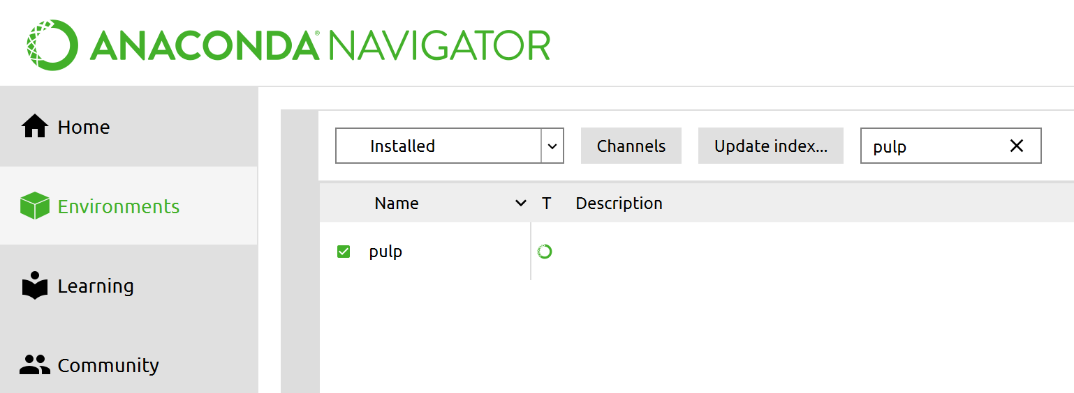
Installing PuLP
To install on Anaconda:
  See the various installation methods provided at:
            https://pypi.org/project/PuLP/
To check if PuLP has been properly installed for Anaconda:
  Go to Anaconda Navigator
  Choose ‘Enviroments’
  Type pulp in the box in the top right corner.
  If pulp appears in the list, it means the PuLP has been installed.

Slide 8
Outline
Formulating LP Problems Using PuLP (not in the textbook)
Examples in Python (not in the textbook)
Exam-1 Review

Slide 9
Formulating LP Problems using PuLP
LP Model
PuLP
  Define the LP problem:
  prob =LpProblem(“name”,LpMaximize)
  Define parameter lists/matrices and index sets:
    Define/Import parameter lists/matrices: c, a, b
    Define index set for decision variables, using a list, say, N
    Define index sets for constraints , using lists, say, M, J1, J2, J3
  Create parameter dictionaries using index set as keys and parameter list as values:
    e.g., objective function coefficients c = dict(zip(N,c))
    e.g., RHS constants, b=dict(zip(M,b))
    e.g., Constraint matrix, a = MakeDict([N,M], a)
Parameter and data structure preparation

Slide 10
Formulating LP Problems using PuLP
LP Model
PuLP
  Define decision variable dictionary using index set as keys
    x=LpVariable.dicts(”x”,N, lowBound=0, cat=“Continuous”)
  Define Objective function
  prob +=lpSum([c[i]*x[i] for i in N])
  Define Constraints
    Use for loop to add constraints in “groups”
    for j in J1:
    prob +=lpSum([a[i][j]*x[i] for i in N]) == b[j]
    for j in J2:
    prob +=lpSum([a[i][j]*x[i] for i in N]) <= b[j]
    for j in J3:
    prob +=lpSum([a[i][j]*x[i] for i in N]) >= b[j]
  7. Solve
  prob.solve()
Problem formulation

Slide 11
Outline
Formulating LP Problems Using PuLP (not in the textbook)
Examples in Python (not in the textbook)
Exam-1 Review

Slide 12
Examples in Python
A Blending Problem – Riverside Oil Company
Riverside Oil Company in eastern Kentucky produces regular and supreme gasoline. Each barrel of regular sells for $21 and must have an octane rating of at least 90. Each barrel of supreme sells for $25 and must have an octane rating of at least 97. Each of these types of gasoline are manufactured by mixing different quantities of the following three inputs:
Riverside has orders for 300,000 barrels of regular and 450,000 barrels of supreme. How should the company allocate the available inputs to the production of regular and supreme gasoline if it wants to maximize proﬁts?
Input | Cost per Barrel | Octane Rating | Barrels Available (in 1000s)
1 | $17.25 | 100 | 150
2 | $15.75 | 87 | 350
3 | $17.75 | 110 | 300

Slide 13
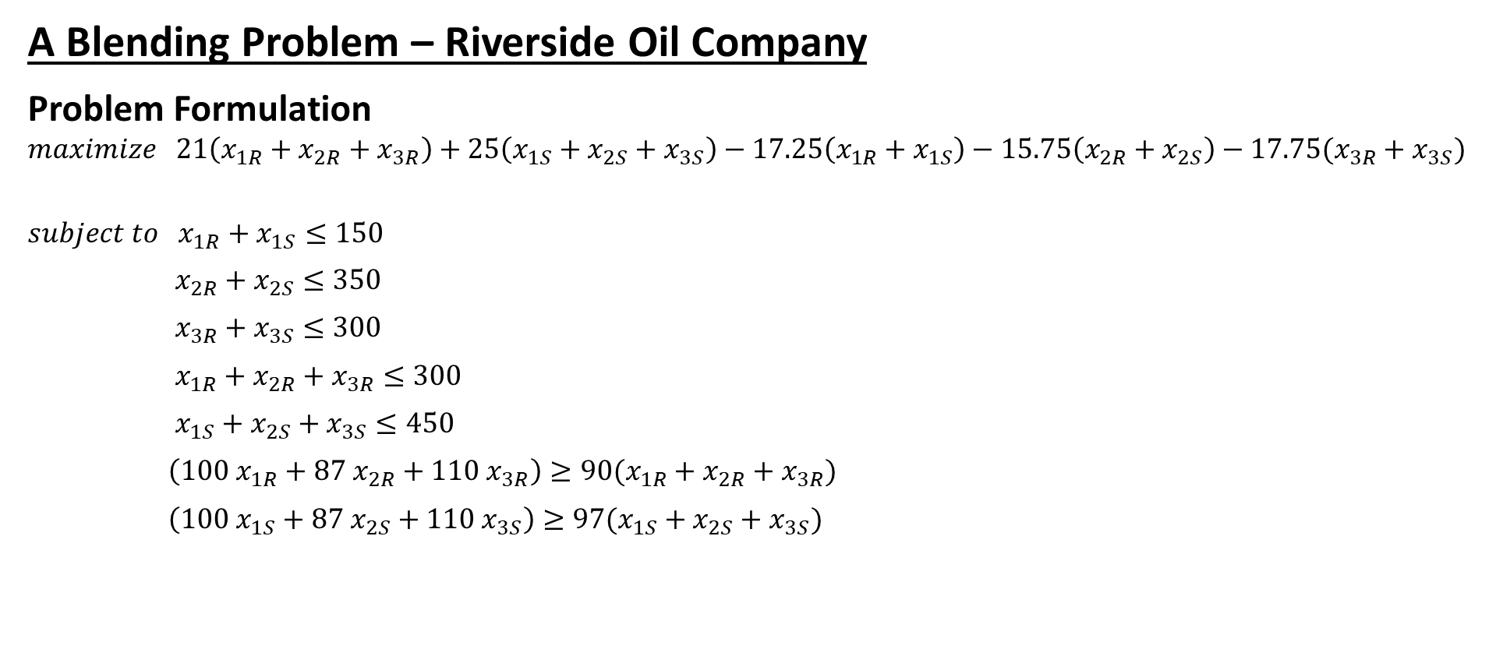
Examples in Python
A Blending Problem – Riverside Oil Company
Problem Formulation
$$maximize 21\left(x_{1R}+x_{2R}+x_{3R}\right)+25\left(x_{1S}+x_{2S}+x_{3S}\right)−17.25\left(x_{1R}+x_{1S}\right)−15.75\left(x_{2R}+x_{2S}\right)−17.75(x_{3R}+x_{3S})$$
$$subject to { x}_{1R}+x_{1S}≤150$$
$x_{2R}+x_{2S}≤350$
$x_{3R}+x_{3S}≤300$
$x_{1R}+x_{2R}+x_{3R}≤300$
$x_{1S}+x_{2S}+x_{3S}≤450$
$\left(100 x_{1R}+87 x_{2R}+110 x_{3R}\right)≥90(x_{1R}+x_{2R}+x_{3R})$
$\left(100 x_{1S}+87 x_{2S}+110 x_{3S}\right)≥97(x_{1S}+x_{2S}+x_{3S})$
Supply Constraints
Demand Constraints
Octane Requirement Constraints

Slide 14
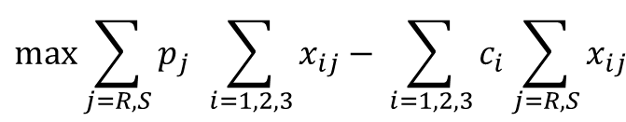

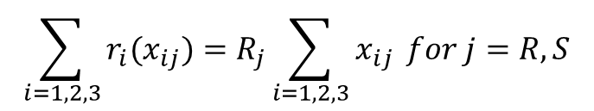
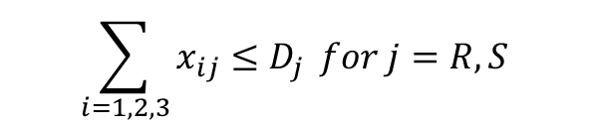
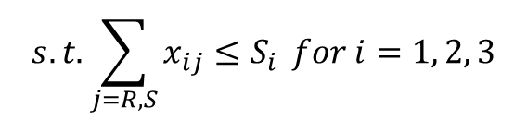
Examples in Python
A Blending Problem – Riverside Oil Company
Total Revenue
$$\max{\sum_{j=R, S}{p_{j } \sum_{i=1, 2, 3}{x_{ij}}}− \sum_{i=1, 2, 3}{c_{i}\sum_{j=R, S}{x_{ij}}}}$$
Problem Formulation
$$maximize 21\left(x_{1R}+x_{2R}+x_{3R}\right)+25\left(x_{1S}+x_{2S}+x_{3S}\right)$$
$−17.25\left(x_{1R}+x_{1S}\right)−15.75\left(x_{2R}+x_{2S}\right)−17.75(x_{3R}+x_{3S})$
$$subject to { x}_{1R}+x_{1S}≤150$$
$x_{2R}+x_{2S}≤350$
$x_{3R}+x_{3S}≤300$
$x_{1R}+x_{2R}+x_{3R}≤300$
$x_{1S}+x_{2S}+x_{3S}≤450$
$\left(100 x_{1R}+87 x_{2R}+110 x_{3R}\right)≥90(x_{1R}+x_{2R}+x_{3R})$
$\left(100 x_{1S}+87 x_{2S}+110 x_{3S}\right)≥97(x_{1S}+x_{2S}+x_{3S})$
Total Cost
$$s.t.\sum_{j=R, S}{x_{ij}≤S_{i}} for i=1, 2, 3$$
$$\sum_{i=1, 2, 3}{x_{ij}≤D_{j}} for j=R, S$$
$$\sum_{i=1, 2, 3}{r_{i}(x_{ij})}=R_{j}\sum_{i=1, 2, 3}{x_{ij}} for j=R, S$$

Slide 15


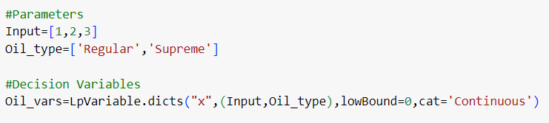
Examples in Python
Import PuLP modeler functions:
Define an LP problem:
Define the parameters and the decision variables:
A Blending Problem – Riverside Oil Company
variable name
problem name
LP problem objective
LpVariable class: LpVariable(name, lowBound=None, upBound=None, cat='Continuous').
name: The name of the variable used in the output.lp file
lowBound: The lower bound on this variable’s range. Default is negative infinity
upBound: The upper bound on this variable’s range. Default is positive infinity
cat: The category this variable is in, Integer, Binary, or Continuous (default)

Slide 16
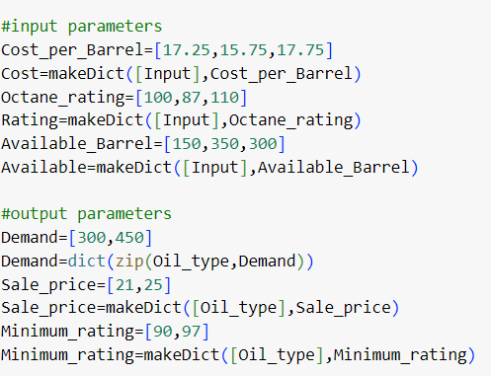
Examples in Python
Generate data:
A Blending Problem – Riverside Oil Company

Slide 17
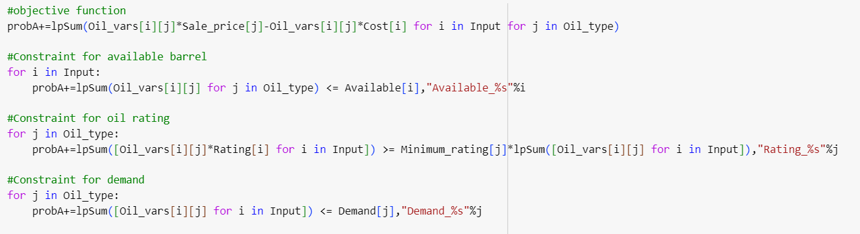
Examples in Python
Add the objective function and constraints to the LP problem using “+=” operator:
A Blending Problem – Riverside Oil Company

Slide 18
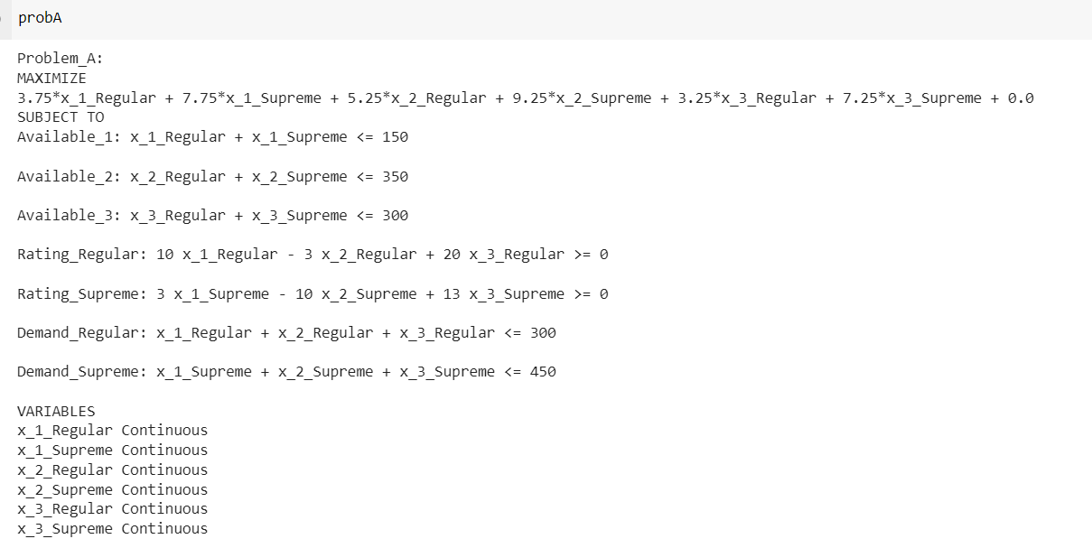
Examples in Python
A Blending Problem – Riverside Oil Company

Slide 19

Examples in Python
Run the solver :
There are 5 status that can be returned from a solver in PuLP:
    Optimal: Optimal solution exists and is found.
    Not Solved: Is the default setting before a problem has been solved.
    Infeasible: The problem has no feasible solution.
    Unbounded: The objective function is unbounded.
    Undefined: Feasible solution hasn't been found (but may exist).
A Blending Problem – Riverside Oil Company
1 | 2 | 3 | 4 | 5
Optimal | Not Solved | Infeasible | Unbounded | Undefined

Slide 20
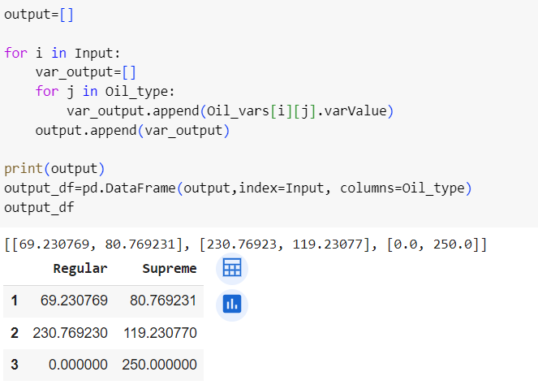
Examples in Python
Print the solution
A Blending Problem – Riverside Oil Company

Slide 21
Examples in Python
Acme Manufacturing makes a variety of household appliances at a single manufacturing facility. The expected demand for one of those appliances during the next four months is shown in the following table along with the expected production costs and the expected capacity for producing these items.
Acme Manufacturing
Month
1 | 2 | 3 | 4
420 | 580 | 310 | 540
$49 | $45 | $46 | $47
500 | 520 | 450 | 550
Demand
Production Cost
Production Capacity

Slide 22
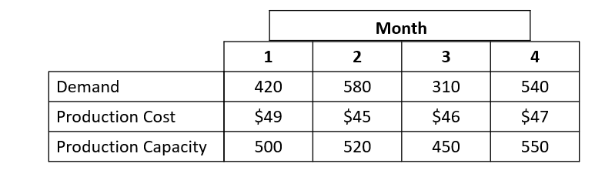
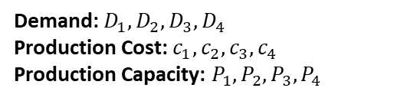
Examples in Python
Acme estimates that it costs $1.50 per month for each unit of this appliance carried in inventory (estimated by averaging the beginning and ending inventory levels each month). Currently, Acme has 120 units in inventory on hand for this product. To maintain a level workforce, the company wants to produce at least 400 units per month. It also wants to maintain a safety stock of at least 50 units per month. Acme wants to determine how many of each appliance to manufacture during each of the next four months to the expected demand at the lowest possible total cost.
Acme Manufacturing
production1
production2
production3
production4
M1
I1
M2
I2
M3
I3
M4
I4
120
Demand: $D_{1}, D_{2}, D_{3}, D_{4}$
Production Cost: $c_{1}, c_{2}, c_{3}, c_{4}$
Production Capacity: $P_{1}, P_{2}, P_{3},P_{4}$
demand1
demand2
demand3
demand4

Slide 23
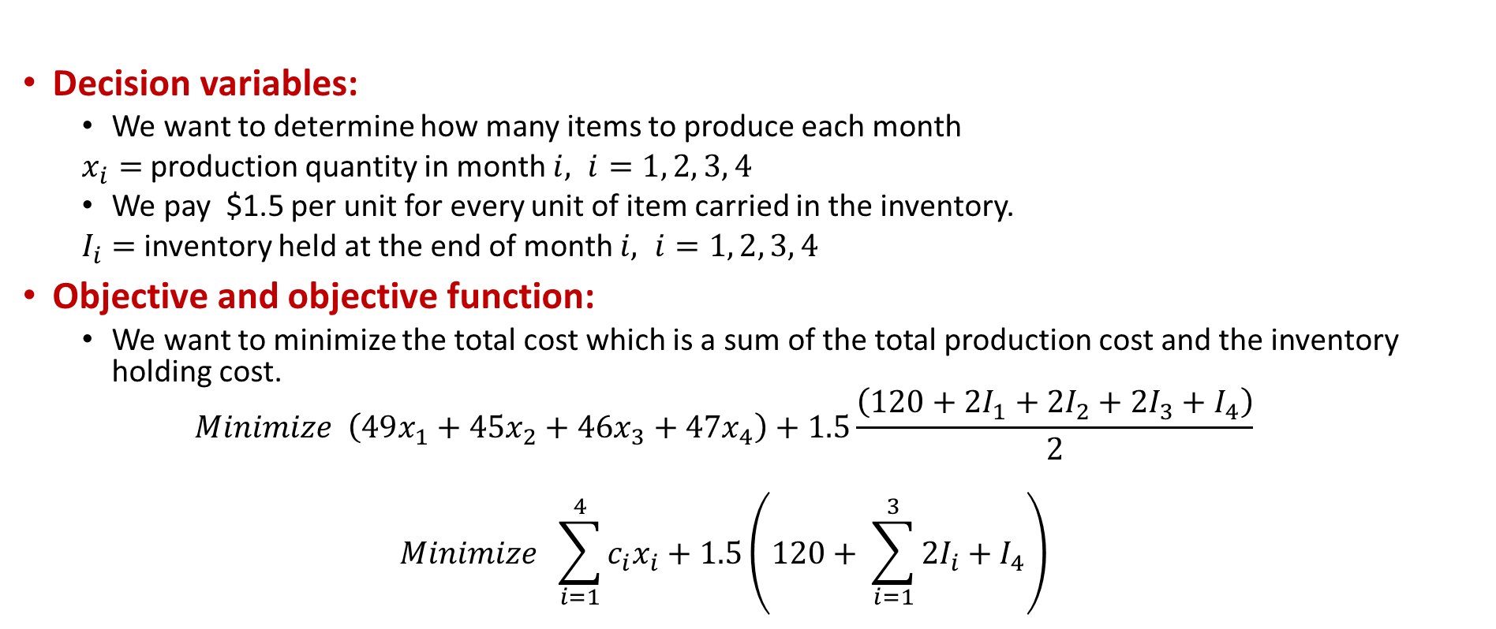
Examples in Python
Decision variables:
  We want to determine how many items to produce each month
  $x_{i}=$ production quantity in month $i, i=1, 2, 3, 4$
  We pay $1.5 per unit for every unit of item carried in the inventory.
  $I_{i}=$inventory held at the end of month $i, i=1, 2, 3, 4$
Objective and objective function:
  We want to minimize the total cost which is a sum of the total production cost and the inventory holding cost.
  $$Minimize \left(49x_{1}+45x_{2}+46x_{3}+47x_{4}\right)+1.5\frac{\left(120+2I_{1}+2I_{2}+2I_{3}+I_{4}\right)}{2}$$
  $$Minimize \sum_{i=1}^{4}{c_{i}x_{i}}+1.5\left(120+ \sum_{i=1}^{3}{2I_{i}}+I_{4}\right)$$
Acme Manufacturing

Slide 24

Examples in Python
Constraints:
  Inventory balance constraint:
  $$I_{i}=I_{i−1}+x_{i} −D_{i} ∀i=1, 2, 3, 4$$
  Production constraint:
  $$400≤x_{i}≤P_{i} ∀i=1, 2, 3, 4$$
  Safety stock constraint:
  $$I_{i}≥50 ∀i=1, 2, 3, 4$$
  Nonnegativity constraint:
  $$x_{i}≥0 ∀i=1, 2, 3, 4$$
Acme Manufacturing

Slide 25
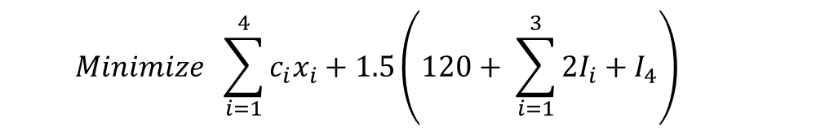
Examples in Python
Combining everything together
Acme Manufacturing
  $$Minimize \sum_{i=1}^{4}{c_{i}x_{i}}+1.5\left(120+ \sum_{i=1}^{3}{2I_{i}}+I_{4}\right)$$
  s.t. $I_{i}=I_{i−1}+x_{i} −D_{i} ∀i=1, 2, 3, 4$
  $$400≤x_{i}≤P_{i} ∀i=1, 2, 3, 4$$
  $$I_{i}≥50 ∀i=1, 2, 3, 4$$
  $$x_{i}≥0 ∀i=1, 2, 3, 4$$

Slide 26
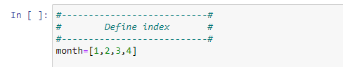
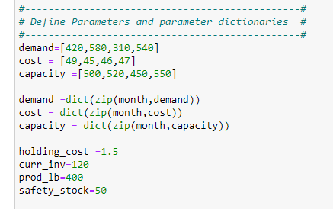
Examples in Python
  Use PuLP to solve the Acme Manufacturing Problem
    Step-1: Define the index as a list
    Step-2: Define the parameters.
Acme Manufacturing

Slide 27
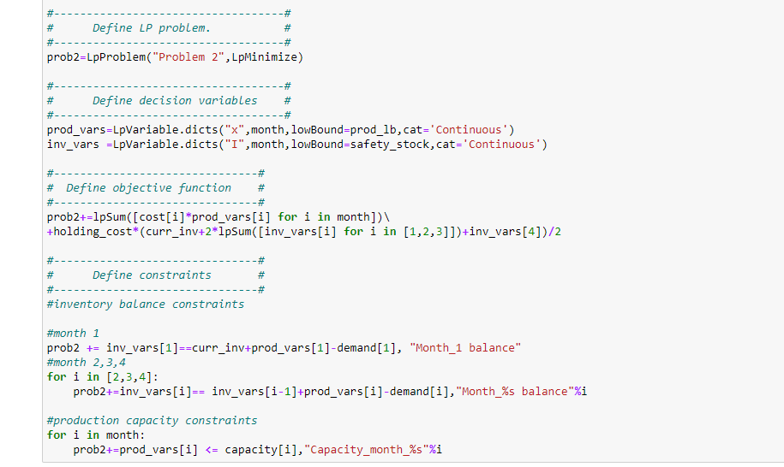
Examples in Python
  Use PuLP to solve the Acme Manufacturing Problem
    Step-3: Define LP problem
    Step-4: Define the decision variables
    Step-5: Define objective function
Acme Manufacturing

Slide 28
Examples in Python
  Use PuLP to solve the Acme Manufacturing Problem
    Step-6: Define constraints
Acme Manufacturing

Slide 29
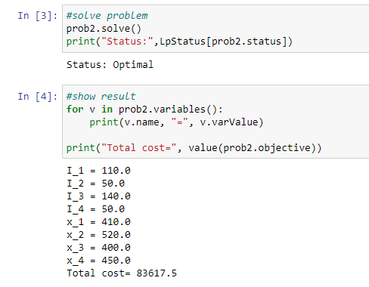
Examples in Python
  Use PuLP to solve the Acme Manufacturing Problem
    Step-7: Solve the problem and display the results
Acme Manufacturing

Slide 30
Outline
Formulating LP Problems Using PuLP (not in the textbook)
Examples in Python (not in the textbook)
Exam-1 Review

Slide 31
Review of Linear Models
First: mathematical formulation of the problem!
    Do not use a variable that is not defined
    If a variable is defined in terms of other variables, this relation should be included as a constraint
    Do not forget non-negativity constraints!!
If all the functions in the model are linear, then the model is linear
  We can have linear integer models, linear binary models, mixed-integer-linear models
  Linear programming assumes, in addition to every function being linear, that the decision variables are continuous
    Step 0: Gather data
    Step 1: Identify the variables
    Step 2: Define the objective function
    Step 3: Define the constraints

Slide 32
Review of Linear Models
Linear programming models:
  Everything is linear (proportionality assumption)
  Decision variables are continuous (divisibility assumption)
Properties of linear programming models:
  Feasible region, unique optimum, alternative optima, unboundedness
    These are also defined for any optimization model
  Graphical solution method, simplex method
Sensitivity analysis:
  Only for linear programming models!
  Sensitivity report and shadow prices!
  Formulating the dual model

Slide 33
Review of Linear Models
Network optimization models:
  Problem definitions of min-cost flow, max-flow, and shortest-path problem
  Mathematical formulation of each problem type
    Decision variables, flow-balance constraints, arc capacity constraints, objective functions
    Defining supply/demand/transshipment nodes, or source/sink nodes, or origin/destination nodes
    The assumptions needed for each formulation
    The tricks to modify the network to make assumptions hold
    Expressing a problem as a network optimization problem
      Defining nodes, node values (if any), arcs, arc costs (if any), arc capacities (if any)

Slide 34
Review of Linear Models
Other topics:
  Spreadsheet modeling and Excel solver details
  Compact formulation and matrix notation
  Converting a problem into a specific form

